Slide 1

Accountability and Omnipresence: Mastering What Comes Next
Explore the journey of self-discovery, overcoming resistance, and building strategic omnipresence to amplify your impact.

Slide 2
Starting with Accountability
Participants' video sharing experiences
  Participants shared 60-second videos to articulate their accomplishments, future plans, and what the world can count on them for next. One participant, Michael, shared a 2-minute video showcasing his progress.
Resistance to self-reflection and vulnerability
  Several participants admitted to procrastination and anxiety around making their videos, highlighting a universal resistance to self-reflection and public vulnerability.
Relationship between completion and graduation
  The coach explained how true graduation is an elevation, and that anxiety, anger, and upset are often signs of internal psychological barriers, which can only be silenced by committing to something bigger next.
Overcoming resistance to self-expression
  Many participants expressed difficulty in completing their video assignments, revealing a common resistance to self-expression and ownership, often masking a deeper fear of fully owning their progress and stepping into visibility.
Celebrating community wins and supporting each other
  The call celebrated wins from community members who are leveraging their growth to expand their impact, such as Sea Rock's Clubhouse-based real estate mortgage coaching program.
The power of presence and omnipresence
  The coach introduced the concept of
Committing to strategic and consistent self-marketing
  The coach announced an exclusive mastermind opportunity to help a select group of individuals commit to monthly events, marketing support, and strategy sessions to grow their brand and impact.

Slide 3

The Relationship Between Completion and Graduation
Completion is a form of ownership that propels individuals forward. Graduation is not just a ceremony but a conscious experience that one must make room for by completing their work and committing to what's next. Overcoming resistance to self-expression and fully owning one's progress is essential for stepping into a transformative graduation experience.

Slide 4

Overcoming Resistance
Resistance to Completing Assignments
Participants Shared Their Struggles
Overcoming Resistance through Completion
Authenticity and Presence over Perfection
Many participants struggled to articulate their accomplishments, future plans, and what the world can count on them for next due to a fear of fully owning their progress and stepping into visibility.
Michael's longer-than-required video reflected his difficulty in condensing his personal growth, while Nima confessed to feeling anxious and delaying the assignment until the last moment.
The coach emphasized that completion creates space for new growth, and that the relationship to completion determines the quality of one's graduation experience.
The coach highlighted the value of one-take content creation, suggesting that authenticity and presence matter more than perfection, as overthinking or overproducing can risk losing the genuine connection that moves people.
By embracing ownership, participants can overcome their resistance and unlock new opportunities for growth and self-expression.

Slide 5

Building Momentum

Slide 6






The Power of Presence
This is where most people start, involving projecting your message, sometimes with self-promotion. Posting frequently does not guarantee impact.
At this level, your message resonates enough that others discuss you because you're doing something worth talking about.
Influencers with real authority and audience begin endorsing or mentioning you, amplifying your reach.
Omnipresence is being everywhere that matters in a way that influences and creates impact.
What is Omnipresence?
Level 1: You Talking About You
Level 2: Others Talking About You
Level 3: Influencers Talking About You
Level 4: Clients Talking About You
Genuine Omnipresence
Commitment is Key
The ultimate level where paying clients advocate for you because of the results you've delivered, not because you asked them to.
Genuine omnipresence requires purposeful marketing, utility, and consistent delivery of value, shifting the focus from self-promotion to serving others.
The coach emphasizes that commitment and marketing yourself strategically and consistently are crucial to ascend to level four omnipresence, just like buying season tickets for a sports team.

Slide 7







The Commitment to Marketing Yourself
Commitment to Showing Up
Creating New Opportunities
Amplifying Your Reach
Client Advocacy

Slide 8
The Role of Self-Awareness and Self-Authorship
Self-Awareness: The Gateway
Recognizing Internal Dynamics
Building Emotional Equity
Self-awareness is the foundation for self-authorship, enabling you to consciously design your life rather than repeat old patterns.
Understanding how early life experiences shape your 'keepers' and coping mechanisms can help you reclaim your power and align with your true purpose.
Developing strong relationships and 'hard energy' with your peers is crucial before you can effectively build or influence others.
Completing and Owning Progress
Consciously Causing Your Future
Finishing current commitments and projects is not about perfection, but about creating space for new growth and opportunities.
Letting go of the past and consciously creating your future self is the key to moving forward and achieving your goals.

Slide 9
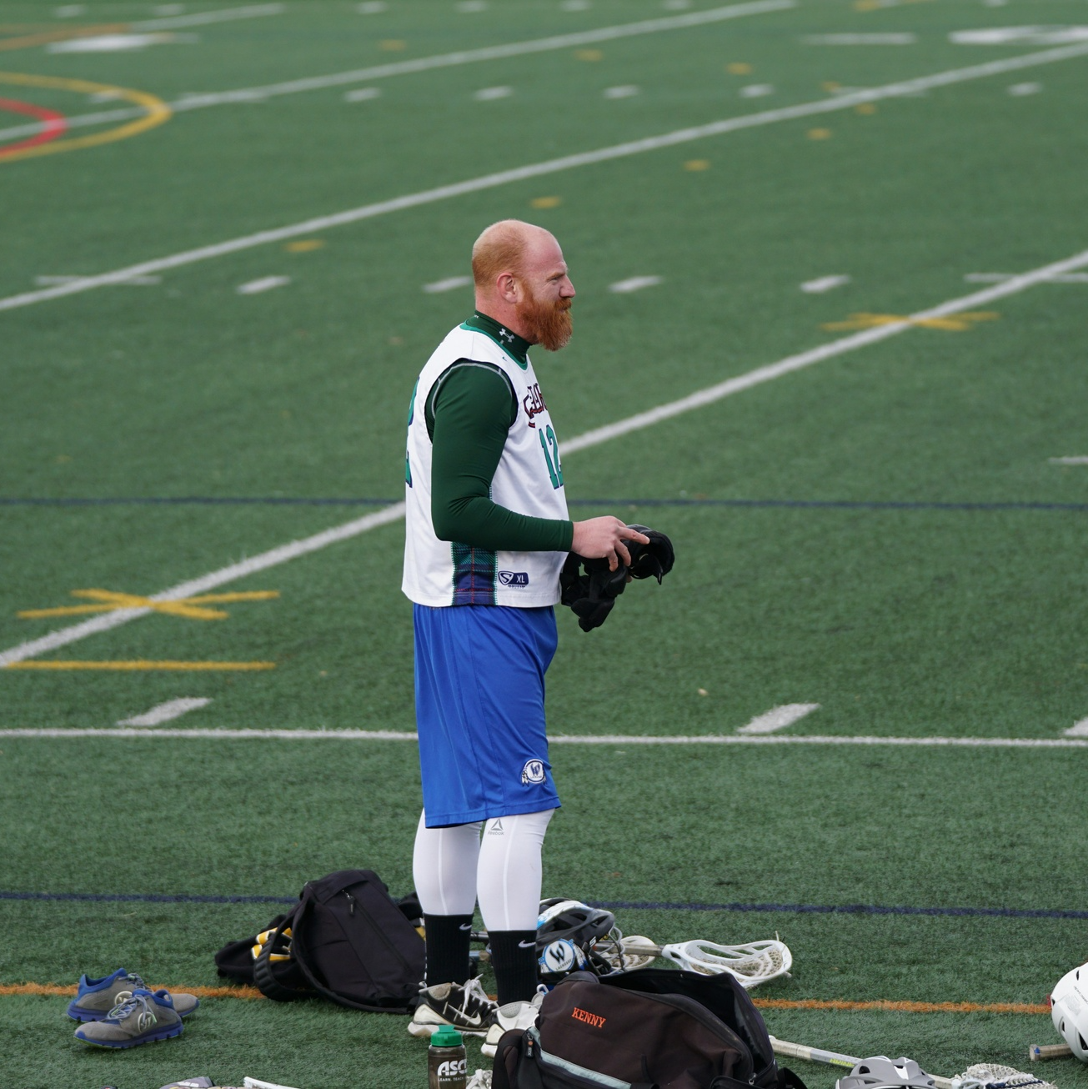

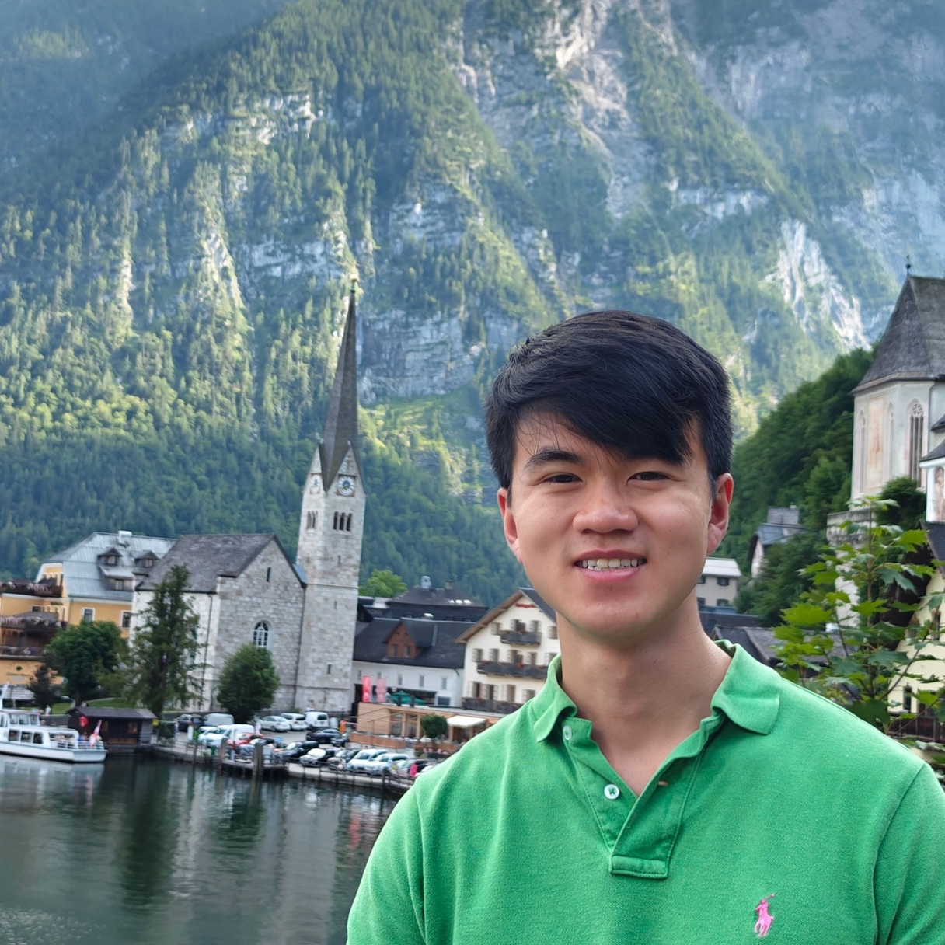

Building Community and Mutual Support
Coach Henry
Alice Johnson
Michael Chen
Sarah Patel
Leadership Coach
Marketing Manager
Software Developer
Community Organizer

Slide 10
What Comes Next
The Importance of Accountability and Completion
  Participants shared their experiences creating a 60-second video to articulate their accomplishments, future plans, and what the world can count on them for next. This exercise was a moment of self-reflection, revealing some participants' resistance to vulnerability.
The Relationship Between Completion and Graduation
  The coach emphasized that true graduation is an elevation, a transcendence from who you were to who you are becoming. Graduation is not just a formality but a conscious experience that requires completing your work and committing to what's next.
Overcoming Resistance to Content Creation
  Many participants expressed difficulty in completing their video assignments, revealing a deeper fear of fully owning their progress and stepping into visibility. The coach shared strategies to preserve authenticity and presence over perfection.
Building Momentum Through Shared Wins
  The call celebrated wins from community members who are leveraging their growth to expand their impact, such as Sea Rock's use of Clubhouse to create new business opportunities in real estate mortgage coaching.
Understanding the Four Levels of Omnipresence
  The coach introduced the concept of
The Commitment to Strategic Marketing
  The coach announced an exclusive mastermind opportunity to help a select group of individuals commit to monthly events, marketing support, and strategy sessions to grow their brand and impact, stressing the importance of consistent self-marketing.

Slide 11
Key Takeaways
Accountability as a Catalyst
  Participants challenged to create video showcasing accomplishments, plans, and commitments
Graduation as Transcendence
  True graduation requires completing work and committing to what's next, overcoming internal barriers
Embracing Authenticity
  Overcoming resistance to self-expression through one-take content creation, public commitment as motivator
Synergistic Community Growth
  Leveraging community growth to expand impact, creating targeted challenges that feed into larger programs
Levels of Meaningful Presence
  Framework for positioning yourself in the market through consistent value and results, not just paid PR

Slide 12

Conclusion
The presentation concludes by emphasizing the need to take consistent, visible action and set sights on what's next, as the key to personal and professional growth. It challenges the audience to complete their current commitments, own their progress, and design a future aligned with their true purpose and values. The coach reminds the group that wrestling with the past is a default position, and to move forward, they must consciously cause and create their future self.

Slide 13
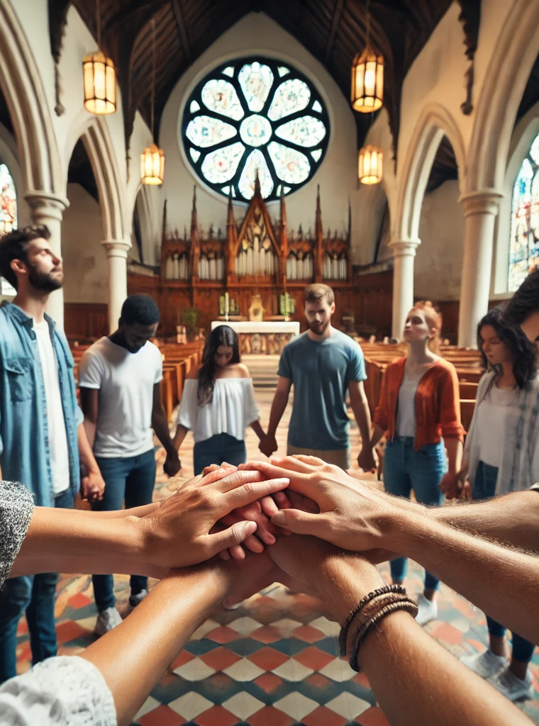
Accountability and Omnipresence: Mastering What Comes Next
Accountability is a transformative force that empowers individuals to create a concise narrative of their accomplishments, future plans, and the impact they aim to have on the world. By embracing vulnerability and committing to public declarations, participants unlock the power of completion, silencing the internal barriers that hold them back.

